Slide 1
SERCOM-3
Third session of the Commission for Weather, Climate, Hydrological, Marine and Related Environmental Services and Applications
Agenda item 2
Report of the President of the Commission
Bali, Indonesia
4-9 March 2024
Presented by:
Ian LISK President of SERCOM

Slide 2
Content
1. SERCOM in the WMO Strategic Plan
2. Structure
3. Highlights
4. Important meetings
5. Cross-cutting activities
6. Key dates 2024-2027

Slide 3
Added at Cg-19

Slide 4
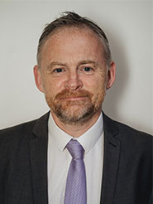
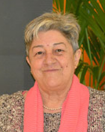
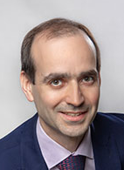
SERCOM structure (before SERCOM-3)
Vice-presidents
SC-AGR
SC-AVI
SC-CLI
SC-DRR
ETs
ETs
ETs
ETs
SC-HYD
SC-MMO
President
14 activities
ETs
ETC (Education, Training and Competency)
MHS (Hazards Science)
CCV (Climate Change & Variability impacts)
+ Thematic Coordinators + Technical Focal Points
CMA (Monitoring & Assessment)
DRC (Data Requirements)
CSIS (CSIS-O)
CID (Info for Decision-making)
CDC (Cap Dev & Comm.)
EWS
CHE (Cataloguing Hazardous Events)
WCM (Humanitarian)
MTG (Tech. Guides)
GSD (General Service Delivery)
Handled by teams formed by SC-HYD members and supported by Associated Experts as necessary
CER (Coastal and Emergency Response)
MS (Maritime Safety)
MOR (MetOcean Requirements)
CCD (Competencies and Cap Dev)
AG-WWMIWS-SubC
AAS (Services)
ASC (Sciences)
DRG (Drought)
ARM (Risk Mgt)
ACDC (Cap Dev & Comm.)
+ TTs TBA
SG-ENE
SG-HEA
SG-URB

Slide 5
SERCOM highlights
SERCOM priority: implementation of the EW4All initiative
SERCOM counts 130 Members
72 WMO Members are represented in the SERCOM Subsidiary bodies
Important experts turnover; changes in the Management Group

Slide 6
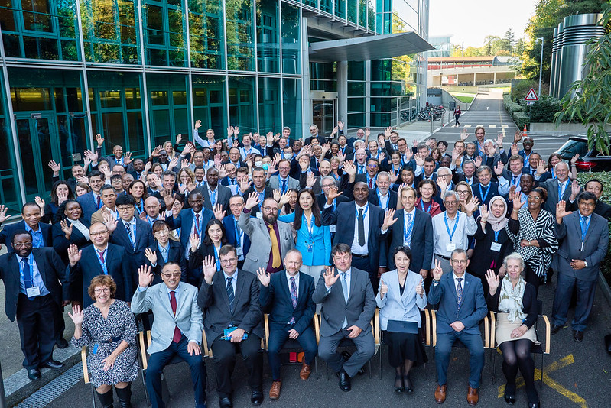
Important meetings since SERCOM-2/1
WMO Constituent body meetings
SERCOM-2
EC-76
EC-77
Cg-19
SERCOM-3
INFCOM-2

Slide 7
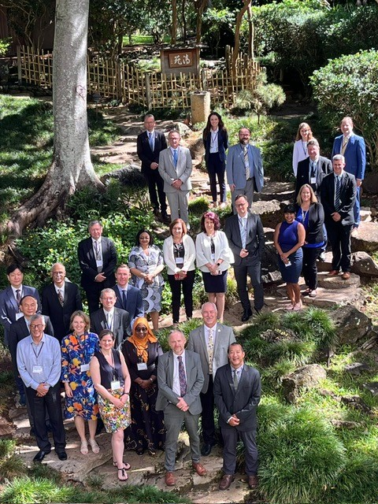
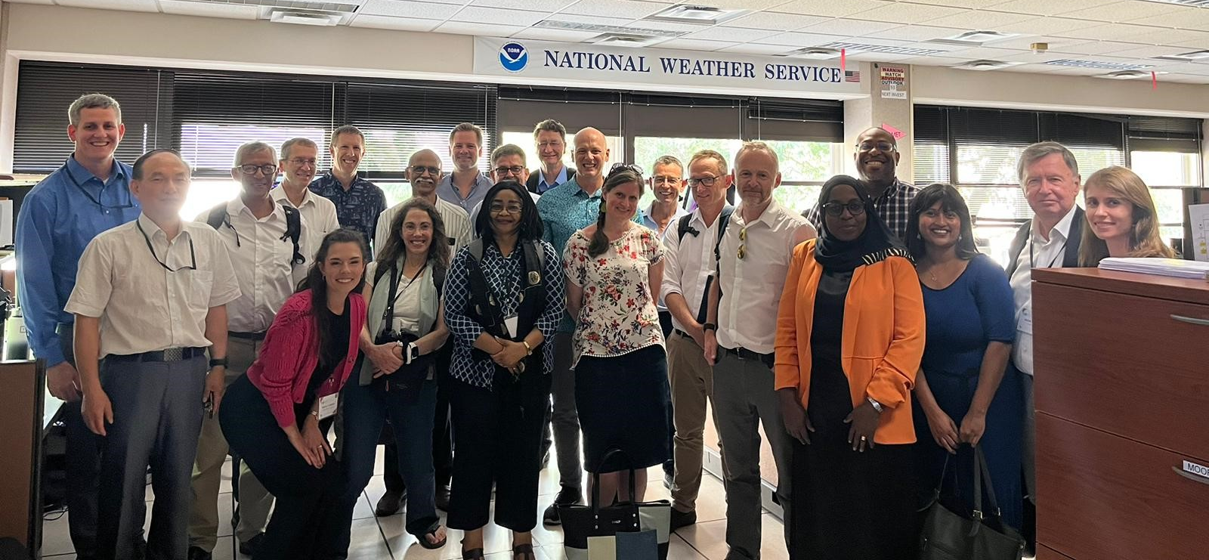
Important meetings since SERCOM-2/2
SERCOM-3 preparation meetings
Regular Execs and MG meetings
Second F2F MG meeting
SERCOM-3

Slide 8
1. EW4All initiative as a key driver of all activities
2. GMAS, UNDRR and WMO Coordination
3. WMO Strategy on Service Delivery
4. WMO Vision and Strategy for Hydrology and its associated Plan of Action
5. Contributions to the WMO Strategic Plan 2024-27
6. Improving expertise/regional/gender & early career scientist balance
7. Contributions to WMO Integrated Processing and Prediction System (WIPPS)
8. Nextgen Global Framework for Climate Services (GFCS)
9. EC-PHORS (Polar & High Mountains) X-sector services
10. Supporting INFCOM’s implementation of the WMO Unified Data Policy
11. Greenhouse Gas Monitoring and Services with INFCOM
12. Review and consolidation of previous/legacy Resolutions/Decisions
13. Restructure, with INFCOM, of WMO Tech Regs & guidance material
14. Participation in sessions of the Conference of the Parties (COP)
SERCOM cross-cutting activities
in collaboration with various bodies in WMO (INFCOM, RB, RAs, HCP, JCB, CDP, TCC)

Slide 9
Key Dates 2024-27
INFCOM-3 (15-19 April 2024) Geneva
TCC-PAC-CDP (22-26 April 2024) Geneva
EC-78 (10-14 June 2024) Geneva
Virtual SERCOM-Execs & F2F SERCOM-MG-3 (February 2025) Geneva (prov.)
Cg-Ext. (16-20 June 2025) Geneva
SERCOM-4 (November 2026) (prov.)
Cg-20 (3-14 May 2027) Geneva

Slide 10
Thank you.
^{wmo.int}

