Slide 1
SERCOM-3
Third session of the Commission for Weather, Climate, Hydrological, Marine and Related Environmental Services and Applications
Agenda item 7(1)
Advice from the Hydrological Coordination Panel and the Capacity Development Panel
Bali, Indonesia
4-9 March 2024
Presented by:
Ian Lisk - P/SERCOM

Slide 2
Draft Decision 7(1)/1 (SERCOM-3)
Decision justification:
Resolution 24 (Cg-18) – Vision, strategy and organizational arrangements for hydrology and water resources in WMO, which established the HCP as the WMO think-tank on hydrology to, among other duties, support an integrated delivery of WMO water-related activities.
Annex 4 to Resolution 7 (EC-77) – Terms of Reference of the HCP, approving the renewed Terms of Reference of HCP and its composition, which includes Chair and Vice-Chair of the Standing Committee on Hydrological Services (SC-HYD).
Final report of the sixth meeting of HCP, held from 17 to 19 January 2024 to review the progress of implementation of the WMO Vision and Strategy for Hydrology and its related Plan of Action (Resolution 4 Cg-Ext(2021)) and to make proposals on its future implementation.

Slide 3
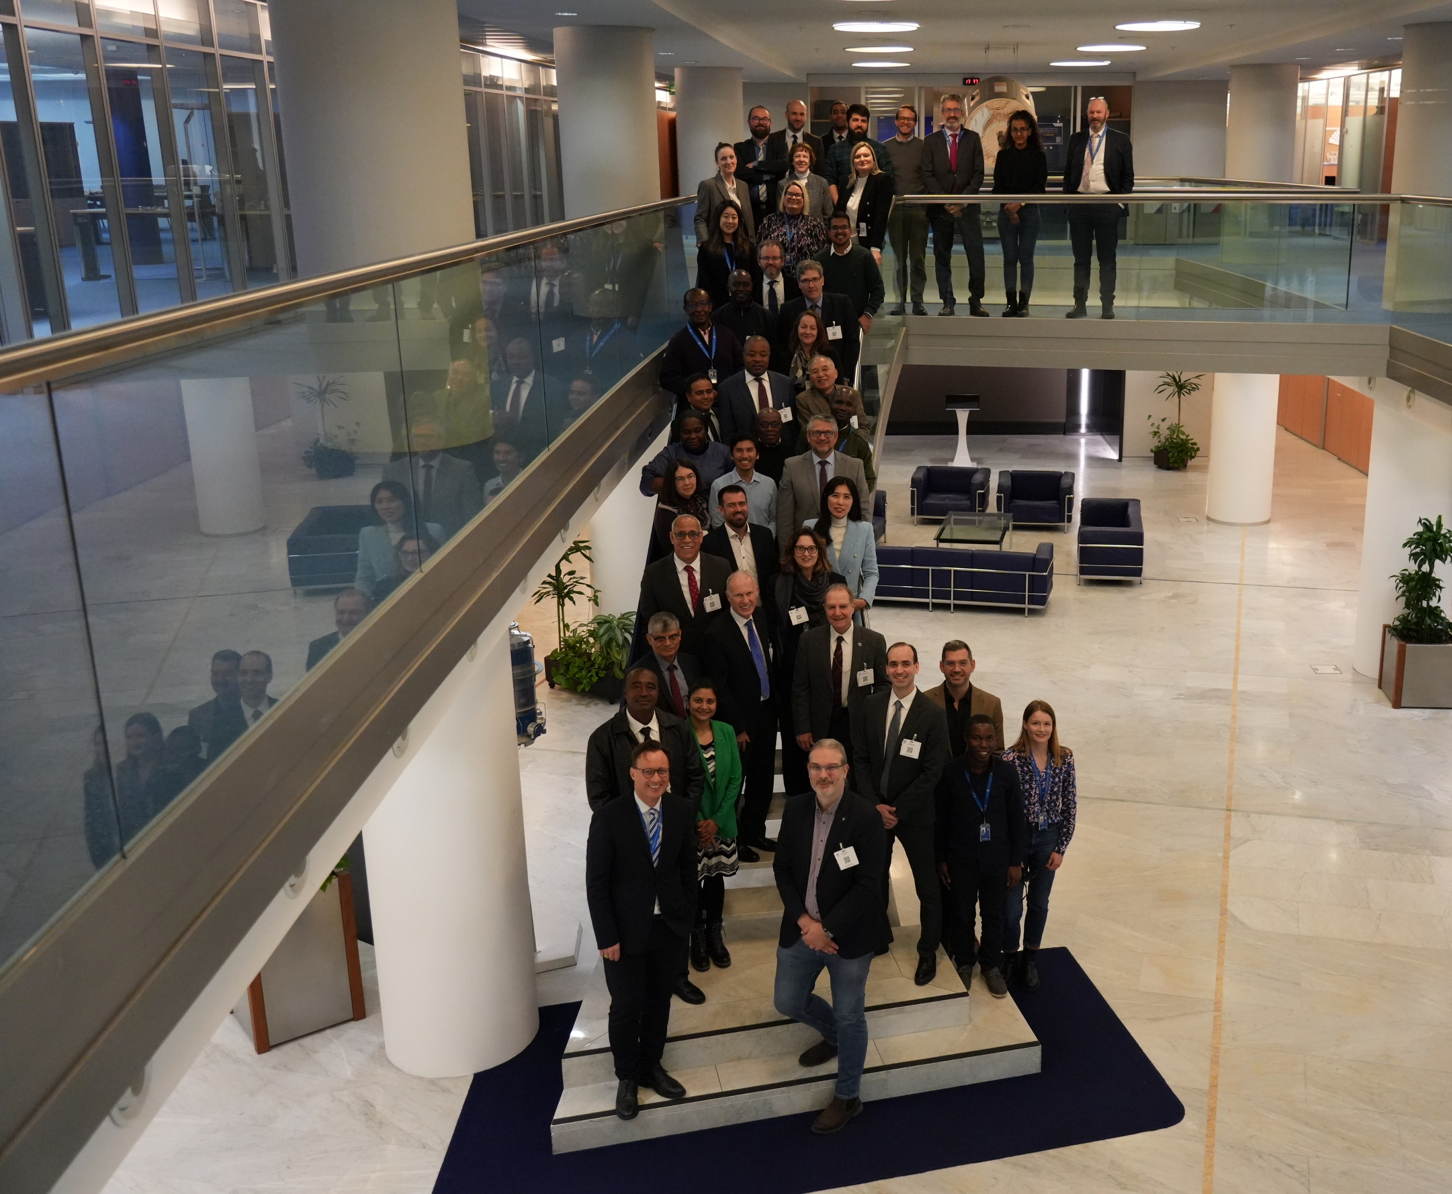
HCP-6, 17-19 January 2024 @ WMO, Geneva

Slide 4
Decisions from HCP-6
HCP Decisions | Comments
4. Requests TCs to modify their workplans according to the updated PoA | Work programme of SERCOM already reflecting the changes to the PoA (see SERCOM/Doc 5.1 and SERCOM/Doc 4.6(1))
6. Invites TCs to review and update of Guide to Hydrological Practice (WMO-168) | Already included in the SERCOM work programme (see SERCOM/Doc 5.1 and SERCOM/Doc 4.6(1))
7. Invites TCs to identify experts to review the Glossary | Reflected in the call of volunteers of SC-HYD (see SERCOM/Doc 4.6(1))
8. Requests Secretariat, HydroSOS, SC-HYD to collaborate with ET-OHPS on standards for hydro forecasting | Reflected (and already ongoing) in the SERCOM work programme
9. Requests HydroSOS Teams (in cooperation with SC-ON, SC-IMT and SC-HYD) to conduct capacity development workshops and develop training material | Reflected (and already ongoing) in the SERCOM work programme

Slide 5
Decisions from HCP
HCP Decisions | Comments
11. Suggests amendments to the SC-HYD Expert Team on Services related to the cryosphere | Suggestions reflected in the proposed ToR contained in SERCOM-3/INF 5.2
12. Agrees on the proposed ToRs of the SC-HYD and the proposed structure of the Programme subcomponent on Hydrological Services | Reflected in SERCOM-3/Doc 5.1 and SERCOM-3 Doc 5.2
13. Recalls that Hydrological Modelling and Forecasting (HM&F) activities are being developed under both TCs across all spatial scales; recalls HCP ToRs to support EC in aligning the hydro work programme across WMO bodies; recognizes the need of coordination in HM&F activities to prevent duplication | Reflected in SERCOM work programme (see SERCOM-3/Doc 5.1 and SERCOM/Doc 4.6(1))
14. Recalls the consensus of HCP to distribute HM&F activities based on the technical requirements instead of geographical or temporal scales; requests C/HCP to consult with P/TCs to ensure that HCP is consulted where HM&F activities are being distributed between TCs | Reflected in SERCOM work programme (see SERCOM-3/Doc 5.1 and SERCOM/Doc 4.6(1))

Slide 6
Draft Decision 7(1)/2 (SERCOM-3)
Decision justification:
Resolution 36 (Cg-19) - WMO Capacity Development Strategy (WCDS), endorsing the WCDS as a framework for capacity development activities.
Resolution 37 (Cg-19) - Education and Training, promoting the competency-based approach.
Resolution 7 (EC-77)– Subsidiary bodies of the Executive Council, retaining the CDP with the terms of reference specified in Resolution 7 (EC-71).
Resolution 7 (EC-71) – Capacity Development Panel, containing the terms of reference of the CDP.
Final report of the CDP-7, particularly Recommendation 1 and Action 3

Slide 7
Decisions CDP
CDP Decisions | Comments
Action 3 – Secretariat to prepare and maintain a list of “requests for advice” directed to the CDP | Ongoing among various bodies of SERCOM (e.g. SC-HYD training of trainers on Assessment of National needs and capabilities for End-to-End Flood forecasting)
Recommen﻿dation 1 – CDP members to give continuation on writing Case Studies to show examples of applying the WCDS framework (at least one case per WMO Regional Association) | Ongoing among various bodies of SERCOM (see Capacity Development Panel | World Meteorological Organization (wmo.int)): - Drought Information System for southern South America (SISSA) - Asia Regional Resilience to a Changing Climate (ARRCC)

Slide 8
Thank you.
wmo.int

