Slide 1
SERCOM-3
Third session of the Commission for Weather, Climate, Hydrological, Marine and Related Environmental Services and Applications
Agenda Item 4.8
Long-term Capacity Development Plan on Services for Energy
Bali, Indonesia
4-9 March 2024
Presented by:
Alberto Troccoli
Chair of SG-ENE

Slide 2
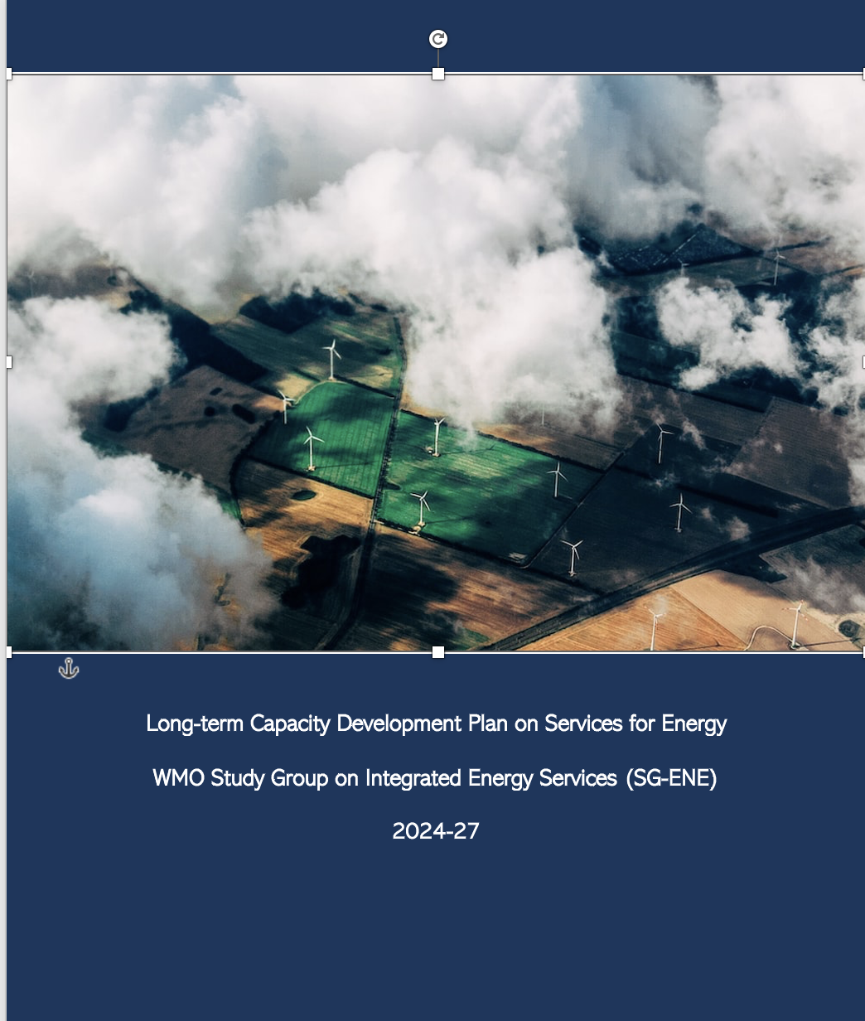
Rationale
The Energy Sector is undergoing a massive transformation due to climate change
Meteorology is going to play an important role for tripling renewable energy capacity with NMHSs are the for front for technical support and services at national level
Enhanced and new capacity is needed to develop and provide advanced weather, climate and hydrological information and services
Target audience: NMHSs and energy meteorologists

Slide 3
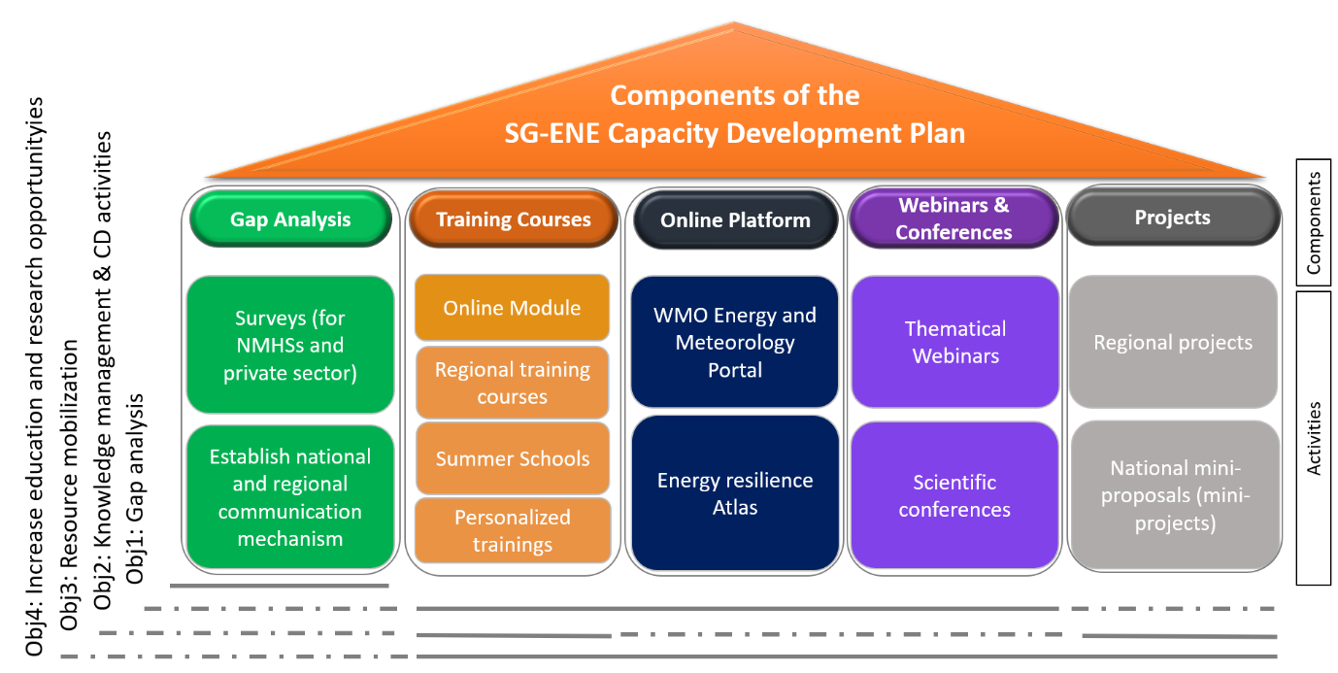
Components & Activities
Continuous Monitor needs and requirements
Training Courses
Online Platform to access actionable info
Webinars and Conferences
Projects
1
2
3
4
5

Slide 4
Expected Action
Draft Decision 4.8 (SERCOM-3)
SERCOM is invited to…
Note the Objectives and Activities of the Plan (Annex 1 and INF 4.8)
Appreciate the Work already started with the SG-ENE
Decide to endorse and support the layout of the Plan 2024-2027
Encourage the Members to work closely with RAs and RTCs to maximize the impacts of the activities
Invite Members to use the Plan as a guiding tool in planning activities in partnership with relevant national stakeholders.

Slide 5
Thank you
^{wmo.int}

