Slide 1
SERCOM-3
Third session of the Commission for Weather, Climate, Hydrological, Marine and Related Environmental Services and Applications
Agenda item 4.7(3)
The collection and dissemination of marine meteorological and oceanographic information using International Maritime Organization (IMO) Recognized Mobile Satellite Services (RMSS)
Bali, Indonesia
4-9 March 2024

Slide 2
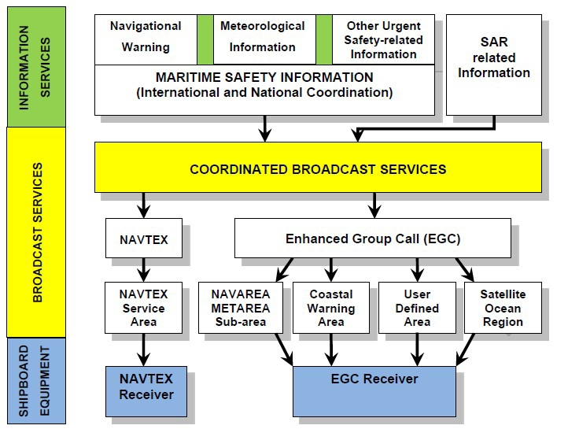
Background/modernization of GMDSS
Via multiple Recognized Mobile Satellite Services (RMSS)
Iridium SafetyCast was recognized by IMO in 2018 as a second RMSS;
Multiple RMSSs enhance the global coverage (incl. polar) of transmission of metocean information;
IMO welcomes more satellite service providers to support GMDSS
INMARSAT
Iridium
Promulgation of Maritime Safety Information (MSI)

Slide 3
Background/justification
Resolution 19 (Cg-XI) 1991 – The collection and dissemination of marine meteorological and oceanographic information using only one RMSS (INMARSAT) – is outdated;
SC-MMO proposes an updated statement to reflect the current operational environment, of more than one RMSS, resulting from the modernization of Global Maritime Distress and Safety System(GMDSS) and the WMO unified data policy;
INFCOM MG concurs with the proposed recommendation (their interest is in the data collection perspective);

Slide 4
Recommendation (1/2) - urges
Services Part
(1) Members with responsibilities or requirements for the provision of meteorological warnings and forecasts for the safety of life and property at sea to study carefully the facilities offered by all IMO RMSS providers for the broadcast of MSI to shipping and to report their experiences in this regard to SERCOM, including any problems which might be encountered, for the benefit of other Members;
(2) Those Members certified to access the EGC RMSS to maximize the benefits to improve early warnings at sea by using all IMO recognized providers;
Observation Part
(3) Those Members operating Land Earth Stations (LES) to continue to accept ships' weather and oceanographic reports transmitted through their LES, free of charge to ships using the special access code 41 short code dialling procedure until this protocol has been retired officially;
(4) Those Members in regions where the expanded coverage of RMSS has produced recognized changes in patterns of data collection and distribution of ship’s weather reports and other observations, to develop interregional, regional, subregional or bilateral agreements for sharing information, as appropriate;
(5) All Members concerned to make every effort to ensure the timely redistribution of reports collected through IMO RMSS to countries in the areas of the geographical origins of those reports;

Slide 5
Recommendation (2/2) - Requests
the president of SERCOM supported by president of INFCOM to continue providing advice on technical and administrative questions which may arise in the expanded global use of the IMO RMSS;
the Secretary-General to continue consultations with the IMO Enhanced Group Call (EGC) Coordinating Panel on the use of the IMO RMSS for the dissemination of MSI to shipping and the collection of ships' marine meteorological and oceanographic reports, and to keep Members closely informed of any significant new developments in this regard, including the availability of alternative free of charge transmission methods.

Slide 6
Thank you.
^{wmo.int}

