Slide 1
SERCOM-3
Third session of the Commission for Weather, Climate, Hydrological, Marine and Related Environmental Services and Applications
Agenda item 4
Establishment and functionalities of WMO accredited entity supporting El Niño/ La Niña information
Bali, Indonesia
4-9 March 2024

Slide 2
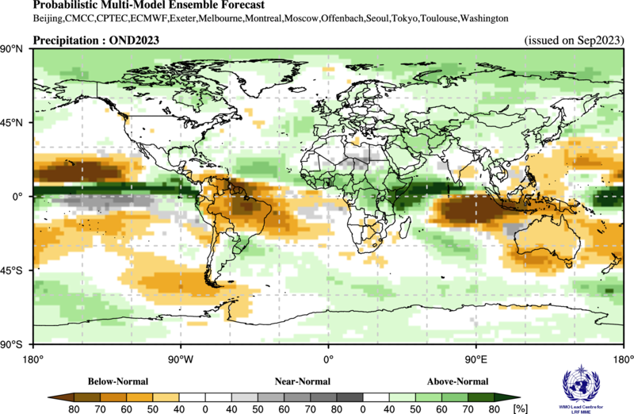
WMO consolidated El Niño/La Niña information mechanism:
Information collection and synthesis, provision of status and outlook including impacts, and product dissemination
Climate outlook October-December 2023
El Niño conditions are present and are expected to continue at least into early 2024 (chance greater than 95% in January–March 2024)
Increasing confidence in the development of a “strong” El Niño event in October–December (about 73% chance) *
Extreme weather and climate events, such as heatwaves, drought and heavy rain are enhanced in some regions
Probabilistic forecast for October-December 2023
Rainfall
Above-normal
East Africa
Parana/La Plata basin
Narrow band along and just north of the equator, from east of the Philippines extending across the equator to the west coast of South America
Below-normal
Northern South America
Maritime continent (Indonesia, the Philippines and Papua New Guinea)
Australia
Parts of Southern Africa

Slide 3
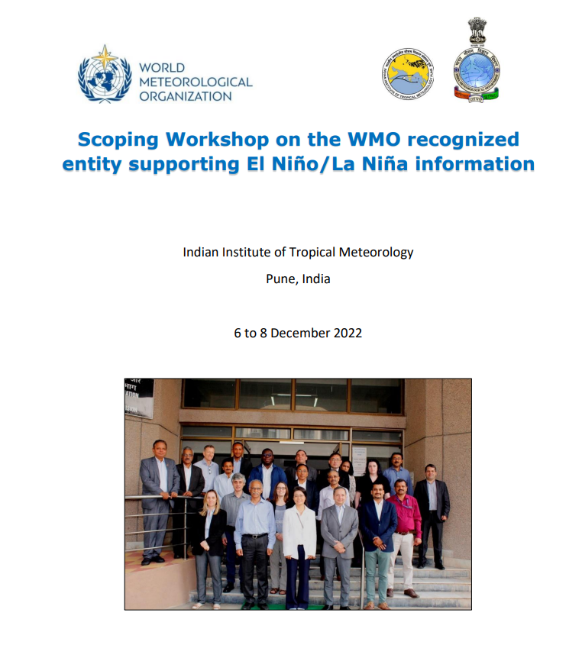
Roadmap
SC-CLI to request made by Decision 7 (SERCOM-2),
WMO Scoping Workshop on the WMO recognized entity supporting El Niño/La Niña information (Pune, India, 6–8 December 2022)
Task Team on WMO accredited ENSO information (TT-ENSO)
Analysis of needs for El Niño/La Niña information from Members, Regional Climate Centres, UN Agencies and the humanitarian community
WMO Survey (2023) on needs and requirements for El Niño/La Niña information
Recommendations on functions and working arrangements

Slide 4
Doc 4.4(3)/1 (SERCOM-3)
Recommendation to EC to endorse the Establishment of WMO consolidated El Niño/La Niña information mechanism (Annex 2).
Concept and functions of the WMO consolidated El Niño/La Niña information mechanism (Annex 1)
Implementation of this mechanism responds to Members needs
Members’ needs to be continually assessed
Concept and functions to be continually monitored to avoid duplication with roles and responsibilities of the existing WIPSS centres and Members
Most efficient and feasible options to be explored to implement the proposed functions
Broad collaboration among stakeholders including INFCOM, SERCOM and research communities

Slide 5
Thank you.
^{wmo.int}

