Slide 1
SERCOM-3
Third session of the Commission for Weather, Climate, Hydrological, Marine and Related Environmental Services and Applications
Agenda item 4
Accelerating Climate Data Stewardship and Data Rescue
Bali, Indonesia
4-9 March 2024

Slide 2
Content of Doc 4.4(1) (SERCOM-3)
Recommendation to EC to request Members
i) to accelerate climate data stewardship implementation (Annex 1) and ii) to endorse exploring DARE implementation in partnership (Annex 2).
Note: Climate Data Stewardship implemented through broad collaboration among stakeholders including INFCOM, SERCOM and research communities

Slide 3
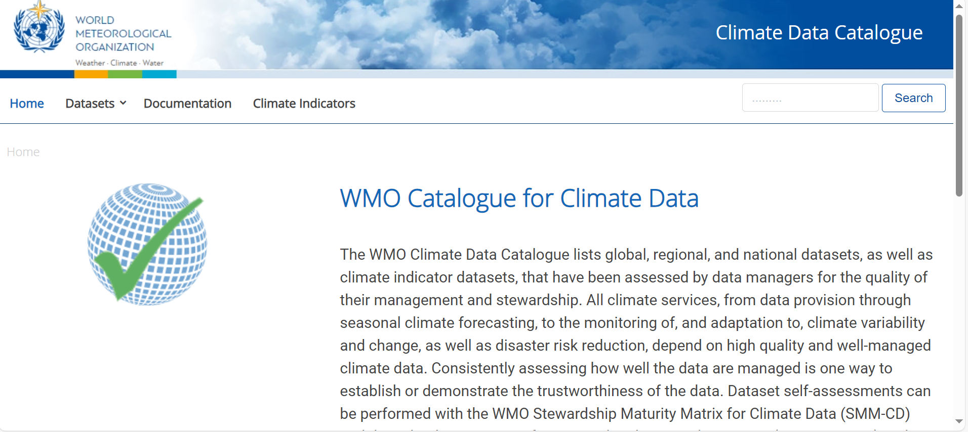
Climate data stewardship: Improving the maturity of stewardship practices for global, regional and national data sets underpinning climate services and WMO flagship products
ET DRC experts led the development of Guidelines: WMO Stewardship Maturity Matrix for Climate Data (WMO-No. 1328)
Instructions, templates, assessed data sets: cf. WMO Catalogue for Climate Data (https://climatedata-catalogue-wmo.org/)

Slide 4
International Data Rescue initiative: Melding together existing WMO and C3S guidelines and portals to enhance efficiency and avoid duplication of efforts
WMO and C3S climate, hydrological, marine and infrastructure experts worked together
- to melding together existing guidelines on data rescue -> update of WMO-No. 1182
- to integrate WMO’s I-DARE portal content into the renovated C3S Data Rescue Portal
!!! SERCOM-3 side event on data rescue: Friday, 8 March, 17:00 !!!

Slide 5
Thank you.
^{wmo.int}

