Slide 1
SERCOM-3
Third session of the Commission for Weather, Climate, Hydrological, Marine and Related Environmental Services and Applications
Agenda Item 4.3(1)
Recommendations and Statement of the Eighth International Workshop on Volcanic Ash (IWVA-8)
Bali, Indonesia
4-9 March 2024
Presented by:
Greg Brock
Head, Services for Aviation Division, WMO

Slide 2
Content
Background
Participation and Theme
Outcomes and Report
Recommendations and Statement
(Summary and word cloud)
Expected Action

Slide 3
VAWS = Volcanic Ash Workshop (International), IWVA = International Workshop on Volcanic Ash
Background
1995 (VAWS-1, Darwin)
1998 (VAWS-2, Toulouse)
2003 (VAWS-3, Toulouse)
2007 (VAWS-4, Rotorua)
2010 (IWVA-5, Santiago)
2013
(IWVA-6, Citeko)
2015 (IWVA-7, Anchorage)
2020-2022
COVID-19 pandemic impacts
2023 (IWVA-8, Rotorua)
2019 Start of WMO governance reform
Today (SERCOM-3)
2027 (IWVA-9, Iceland)
[Tentative]
Since mid-1990s, workshops convened typically once every 3 to 5 years
WMO in collaboration with ICAO and other relevant agencies such as IUGG
Purpose:
Foster engagement between research, operations and user communities
Promote the science-to-service value-cycle
Respond to current and future aviation user needs and expectations
Showcase state-of-art meteorological and volcanological developments
Aid the closing of implementation gaps among service providers
Recommendations and Statement

Slide 4
Participation and Theme
4 and 5 February 2023, Rotorua, New Zealand
‘Sandwiched’ IUGG IAVCEI Scientific Assembly and conjoint WMO and ICAO meetings
Nearly 60 participants of which 40% were women
Developed and developing countries representation, including LDC and SIDS
Volcanology, geophysics and meteorology scientific researchers and operational personnel
Aviation industry representatives from airline operators, engine manufacturers and regulatory authorities
“From the 2010s to the 2020s and beyond: Managing and mitigating volcanic risks to aviation with an explosion of science”

Slide 5
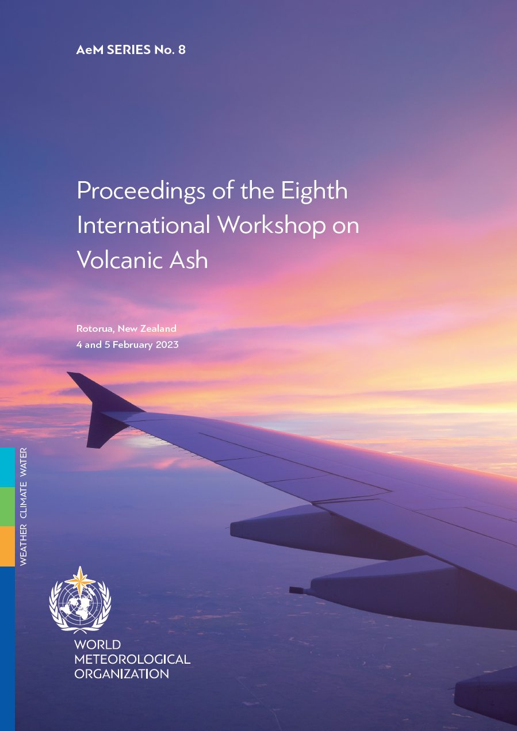
Outcomes and Report
Published June 2023
Thematic areas:
Airframe, engine and avionics susceptibility developments and industry needs
Recent development and upcoming challenges and opportunities for volcano observatories and meteorological services
Next-generation of volcanic hazard services for aviation
Format:
4 keynote addresses
15 oral presentations
9 poster presentations
3 panel discussions
3 x Recommendations
1 x Statement
Rated 4.4 stars out of 5
by participants
Annex to Draft Resolution 5.3(1)/1 (SERCOM-3)

Slide 6
Recommendations and Statement (Summary)
R1
R2
R3
S1
Strengthen community engagement
Share relevant data in a timely manner
Ensure better support aviation users’ safety risk assessments
Address education needs of aviation users
Convey aviation users strategic and operational decision-making to service providers
Secure sustainable funding mechanisms
Review utility of VONA and aviation colour codes
Enable access to catalogues of volcano characteristics
Strengthen cooperation across service providers
Ensure State volcano observatory access to information for effective volcanic hazard monitoring
Promote education and training through transition from products to services
Actively explore emerging, innovative scientific and technological advances including ensembles and data fusion
Clearly communicate strengths and limitations of the supporting science and the information supplied to users
Enthusiastic support for WOVO to be reinvigorated under IUGG/IAVCEI
Challenges and opportunities linked to accelerating pace of scientific and technological advances and comparative lag of international standards
Necessity for enhanced collaboration between volcanological and meteorological communities, especially to help close implementation gaps
Institutional knowledge gaps could hamper progress within the IAVW
Inconsistent application of VONA and aviation colour code is a challenge for aviation users
The need for SO₂ information service and any service-level capability and response requires further careful consideration in context of IAVW

Slide 7
WORD CLOUD
Top-50 words that appear in the IWVA-8 Recommendations and Statement

Slide 8
Expected Action
Draft Recommendation 4.3(1)/1 (SERCOM-3)
SERCOM is invited to…
Note the responsibilities of SC-AVI
Appreciate the convening of IWVA-8
Appreciate the publication of a comprehensive report on IWVA-8
Examine the recommendations and statement of IWVA-8
Consider the IWVA-8 outcomes to be of utmost importance to the further development of the IAVW
Suggest that IWVA-9 should, subject to resources and other considerations, be convened in 2024-2027, preferably in 2027
Recommend to EC-78 the endorsement of the recommendations and statement of IWVA-8

Slide 9
Thank you
^{wmo.int}

