Slide 1
SERCOM-3
Third session of the Commission for Weather, Climate, Hydrological, Marine and Related Environmental Services and Applications
Agenda item 4.10
Integrated Urban Services
Bali, Indonesia
4-9 March 2024
Presented by:
Dr. Feng Liang
Chair SG-URB

Slide 2
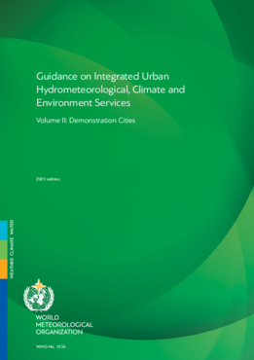
4.10 Integrated Urban Services
Good Practice for the Implementation of Integrated Urban Services is the 3rd volume in a series.
Volume I: Concept and Methodology (WMO-No. 1234, 2019)
Volume II: Demonstration Cities (WMO-No.1234, 2021)
This Good Practice report is accompanied by a report :
Good Practice for Assessing Socio-economic and Organizational Costs and Benefits for Integrated Urban Services
Volume I Volume II
Notes:
The work of the SG-URB has been the development of materials for the creation of Integrated Urban Services to support specific goals of the WMO strategic Plan 2020-2023.
This time we submit 2 good practice documents to the Plenary. The first is Good Practice on Implementation of Integrated Urban Services, which is the 3rd volume in a series of IUS guidance. (The Volume I: Concept and Methodology was published in 2019; the Volume II: Demonstrtion Cities was published in 2021.)
This Volume III is accompanied by a report: Good Practice for Assessing socio-economic and organizational costs and benefits for IUS, which is the second document we submit to the Plenary.

Slide 3
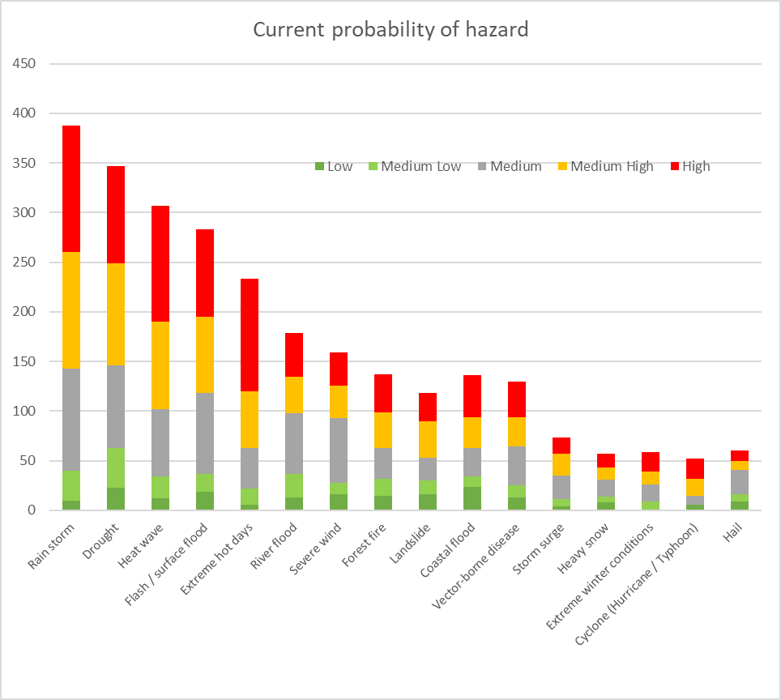
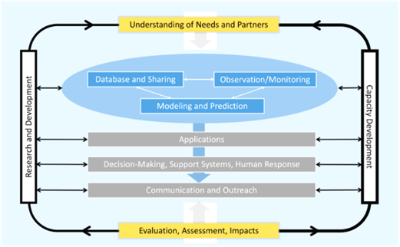
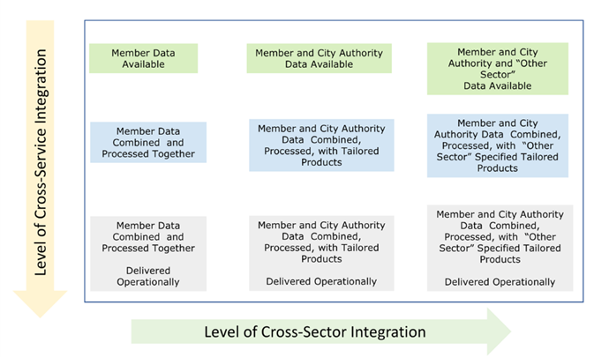
4.10(1) Implementation of IUS
Contents
Introduction
Assessing user needs
Scientific infrastructure
Evaluation: Assessments and impacts
R&D and capacity building
Recommendations
Notes:
The development of IUS by the WMO can be seen within the context of United Nations 2030 Sustainable Development Goals, specifically SDG 11: Make ciiteis inclusive, safe, resilient and sustainable. The core priniple of an IUS is that service providers and users co-operate to maximise the value of scientific knowledge for cities.
Implementation of IUS focuses on provide good practices for Members to support the development of high value services for the urban ecosystem.
It recognizes the need to integrate user needs, scientific infrastructure and capacity building in the excercise.
It also provide practical recommendation on how to start and build up IUS.

Slide 4
4.10(1) Implementation of IUS
Recommendations
WMO Members and Cities have distinct roles to play but must co-operate in some fundamental areas to allow mutual sharing of data, design and evaluate applications, create warning and delivery systems.
The WMO Member and the City together need to have a geospatial data-sharing platform for the exchange of information.
The primary role of the WMO Member should be to provide the environmental knowledge needed to suppot risk management and reduction in cities and to support is day-to-day operations.
The city is primarily responsible for making use of this knowledge. It is best placed to establish a network of urban stakeholders that can help co-produce IUS.

Slide 5
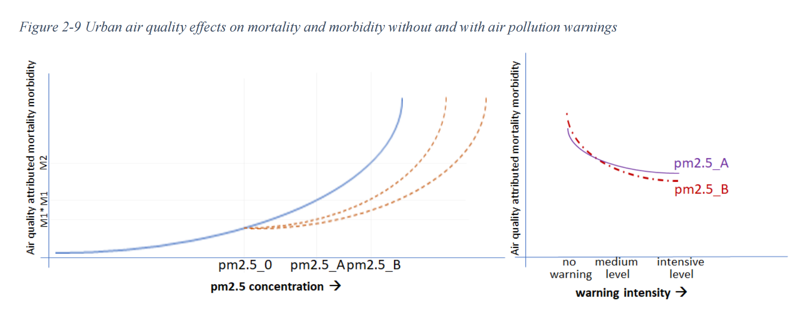
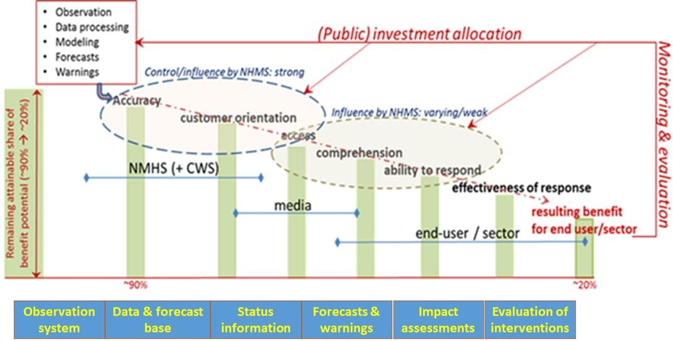
4.10(2) Assessing socio-economic and organizational costs & benefits of IUS
Contents
Introduction
Economic and regulatory factors
Inventory of user communities and their demand profile
Options to build an IUS ecosystem
Identifying benefit potentials of IUS
Cost-Benefit to value IUS
Key messages
Notes:
An important support for the deployment of IUS is the ability to indicate its expected societal benefits and to identify the critical factors that affect the realization of the societal benefits. This report provides a cost-benefit analysis methodology and a few examples for assessment of the institutional costs and the socio-economic benefits of IUS. It also provides metrics and benefit potentials of IUS to continue and build an ecosystem to sustain service delivery.
Key messages include:
1. It is essential that the design, operation and innovation of IUS products is guided by impact measurement of the urban functions IUS is supposed to support. Such indicators can guide IUS product development and updating, as well as the performance shown by these indicators helps to ensure sufficient resourcing for the development and maintenance of IUS.
2. Affordable open IUS data enable many expert organisations to develop or improve their own expert (information) services, which in turn can contribute to the sustainability and resilience objectives and raise well-being.
3. To ensure proper valuation of the direct benefits of IUS, it is important to monitor the use and the effectiveness of use. In combination with the value chain approach this offers a basis to assess the net benefits. Based on valuations of weather and climate services, it may be expected that IUS have positive net benefits for society.
FROM THE EXEC SUMMARY (below)
IUS are an emerging product-service cluster within, and yet also beyond, the hydrometeorological sector. IUS is driven by: 1) data needs associated with climate adaptation and mitigation activities, 2) ever lower unit-cost of observation and data-processing, with consequent blurring of the original domain bounds of several actors, and 3) the growing popularity of the smart city concept. The combination of these drivers results in the smart sustainable and resilient city, as an overarching strategic objective to which diverse and efficient IUS constitute a building block. The objective also emphasizes the integration of information resources, services and delivery options
The services delivered by IUS will often be entirely public and hence free of charge. Nevertheless, IUS can also contain professional segments which are not free of charge. From a smart city point of view providing open data is important. Yet, not all data need to be free in case of commercial use, as long as they are affordable, quality assured, and easily accessible. Revenues can be used to develop the service portfolio and the open data repositories. Affordable open IUS data enable expert organisations to develop or improve their own expert (information) services, which in turn can contribute to a city’s sustainability and resilience objectives and raise well-being.
IUS consist mostly or wholly of merit goods, i.e. goods or services which companies and citizens tend to use less than would be good for them in terms of welfare and health. The merit character supports the principle that the services should be free of charge or at least affordable, and easily accessible. To ensure proper valuation of the direct benefits of IUS it is important to monitor the use and the effectiveness of use. In combination with the value chain approach this offers a basis to assess the net benefits. Based on published valuations of weather and climate services it is expected that IUS have mostly positive net benefits for society. It is, however, possible that the current version of an IUS still contains a lot of missed opportunities.
In addition to valuation in monetary terms it is also justified to assess social and ecological benefits in their own metrics, such as represented by many Sustainable Development Goals.
Cities that not yet have IUS are advised to 1) identify their strategic objectives to which IUS can contribute and 2) translate these targets into a set of concrete information and service needs in cooperation with key actors.

Slide 6
Decisions 4.10(1) and 4.10(2)
“To recommend to the Executive council to encourage Members to adopt the good practices for
Implementation of Integrated Urban Services (IUS) and
(2) Assessing socio-economic and organizational costs and benefits for IUS”
Notes:
We propose the Plenary to endorse these two documents and to recommend to the Executive Council to encourage WMO Members to adopt the good practices and include them in their efforts to improve service delivery in urban settings.

Slide 7
شكراً
Thank you
Gracias
Merci
Спасибо
谢谢

