Slide 1
Status of Members’ Contributions
Cg-19/INF 6.3
19 May 2023

Slide 2
Status of Contributions as at 30 April 2023

Slide 3
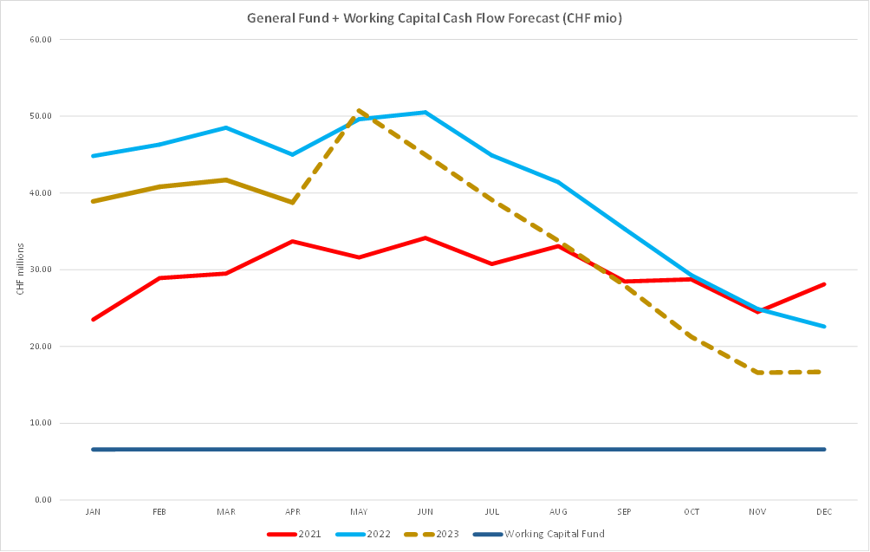
Status of Regular Budget Cash Position, including forecast for 2023

Slide 4
Summary
Increased level of arrears at the beginning of 2023, offset by improved payments in first 4 months of 2023
Level of Members who have fully paid ,and those who have made some payments, during 2023 has increased as compared to 2022
Fewer Members without voting rights as compared to 2022
General Fund cash position remains strong
However:
Total outstanding balance represents 79% of the 2023 assessment
Continued focus on payment of assessments is required to ensure efficient implementation of the programme

Slide 5
Reflection in EC-77 Document
EC-77/Doc. 5 - Executive Council:
Notes with concern the substantial amounts of outstanding assessed contributions of certain Members as described in Cg-19/INF. 6.3;
Urges Members to make the payment of outstanding assessed contributions a matter of highest priority and to make every effort to clear their dues as soon possible.

Slide 6
FINAC Recommendation
Recommendation 2:
“That Congress and the Executive Council urge Members with unpaid contributions to settle their dues as early as possible and as a matter of highest priority, as delayed settlement may have a significant negative impact on the programmes and operations of the Organization and may expose the Organization to the risk of not being in a position to pay its obligations to third parties when they become due.”

