Slide 1
Maximum Expenditures for the nineteenth Financial Period (2024-2027)
FINAC-43
Cg-19/Doc. 3.1(2) and Cg-19/INF. 3.1(2)
19 May 2023

Slide 2
Agenda
Overall Context 2024-2027
Process to Date
Summary of Maximum Expenditure Scenarios including Key Priority Areas
Additional Details
Objects of Expenditure
Draft Resolution

Slide 3
Overall Context 2024-2027

Slide 4
WMO Strategic Plan 2030
Vision
A world where all nations, especially the most vulnerable, are more resilient to the socioeconomic impact of extreme weather, climate, water and other environmental events, and empowered to boost their sustainable development through the best possible weather, climate and water services
Overarching Priorities
Preparedness for, and reducing loss of life, infrastructure and livelihood from hydrometeorological extremes
Climate-smart decision-making to build resilience and adaptation to climate risk
Socioeconomic value
of weather, climate, hydrological and related environmental services
Core Values
Accountability for results and transparency
Collaboration and partnership
Inclusiveness and diversity
1
3
Member Services
Close the capacity gap
5
Services
Better serve
societal needs
Infrastructures
Enhance Earth system observations and predictions
Science and Innovations
Advance targeted research
Smart
Organization
Strategic realignment of WMO structure and programmes
Long-term Goals
2
4
Strategic Objectives
Focus areas for
2024-2027 ⇣
National multi-hazard early warning/alert systems
Policy- and decision-supporting climate information & services
Hydrological services
Decision-supporting weather information & services
Changes in the cryosphere and downstream impacts
Acquisition of Earth system observation data (WIGOS)
Access to, exchange and management of Earth system observation data and products (WIS)
Access to and use of numerical analysis and Earth system prediction products
Advance scientific knowledge of the Earth system
Enhance science-for-service value chain to improve predictive capabilities and analysis
Advance policy-relevant science
Enable developing countries to provide and utilize essential services
Develop and sustain core competencies and expertise
Scale up partnerships for investment in sustainable cost- efficient infrastructure and service delivery
Optimize WMO constituent body structure
Strategic partnerships
Advance equal, effective and inclusive participation
Environmental sustainability

Slide 5
Maximum Expenditure Scenarios (2024-2027)
 | Zero Nominal Growth (ZNG) | Zero Real Growth (ZRG) | Secretary-General’s Proposal
Delivery of Core Mandate
Delivery of EW4All
Delivery of Key Priority Areas
Change in funding levels from 2020-2023 | - | +2.4% | +6.9%
Full implementation
Partial implementation
No implementation

Slide 6
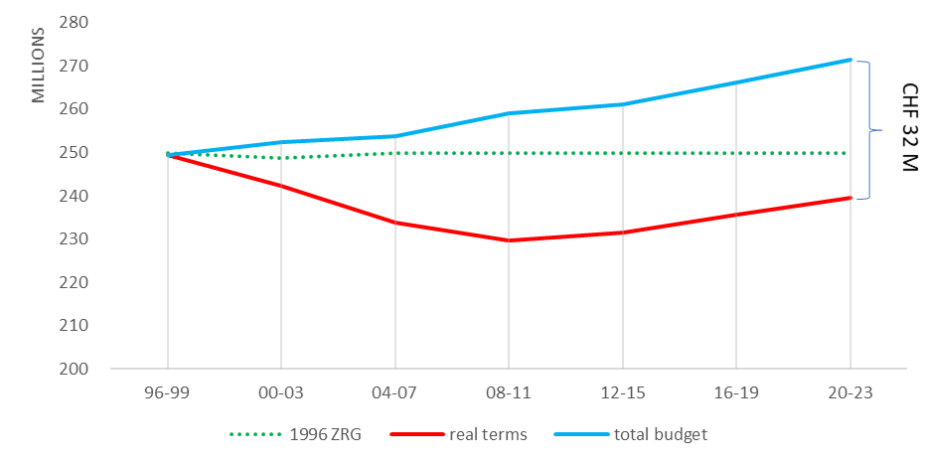
Historical Inflation
Impact of Inflation on the WMO regular budget 1996 – 2023:

Slide 7
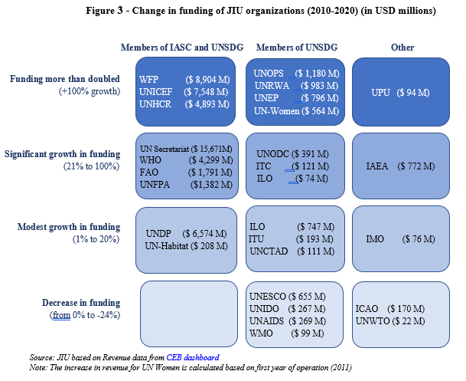
Comparison of UN System revenue 2010-2020 (all sources)

Slide 8
Incremental budget from ZNG to ZRG and SG’s Proposal Scenarios
(in CHF thousands)
Element | ZRG Scenario | SG’s Proposal
Maximum Expenditure at ZNG 2024-2027 | 271,544.4 | 271,544.4
Incremental Early Warnings for All | 2,570.5 | 2,570.5
WMO-coordinated Greenhouse Gas Watch | 1,899.9 | 2,649.9
Regional and Representative Office Reform | 2,225.1 | 3,210.3
Plan of Action for Hydrology | 865.8 | 865.8
Cryosphere and Downstream Impacts | - | 1,357.2
De-prioritized activities to fund ZRG | (4,614.3) | -
ERP System and IT Strategy Implementation | 3,580.0 | 3,580.0
Additional Programmatic Requirements | - | 4,618.3
Maximum Expenditure Scenario 2024-2027 | 278,071.4 | 290,396.4

Slide 9
Process to date

Slide 10
Context for approval Maximum Expenditures 2024-2027
FINAC-41
EC-76
EC-75
FINAC-42
PAC
FINAC-43
Maximum Expenditure document responding to consolidated recommendation in EC-76 13/1
Incorporate a ZRG Scenario
EW4All is highest priority within each Maximum Expenditure Scenario
Supporting the Enterprise Resource Planning (ERP) system and implementation of IT Strategy is crucial
Identification of what activities have been de-prioritized, and the related impact, under ZRG to allow for funding key priority areas
Identification of resource mobilization and partnership efforts foreseen to further support key priority areas
EC-75/INF. 4(1d)
EC-76/INF. 5
Cg-19/INF. 3.1(2)
Congress-19
Decision making on Maximum Expenditure for financial period 2024-2027

Slide 11
Alignment with the Strategic and Operating Plan
Strategic Plan
Maximum Expenditure
Operating Plan
Long-Term Goals
Strategic Objective
Focus Areas
Outputs
All scenarios are fully aligned with the Strategic Plan and Operating Plan and considering:
EW4All as top priority
Financial constraints on Members
inflationary factor
Potential additional efficiencies
The level of delivery of Strategic Plan differs in each maximum expenditure scenario due to limitations on availability of funding – primary implications as shown in the Operating Plan are reduced scope and delayed timing of delivery, thus reducing the WMO impact

Slide 12
Summary of Maximum Expenditure
Scenarios

Slide 13
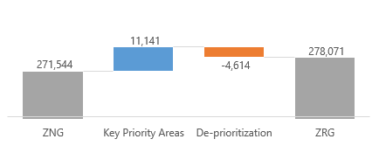
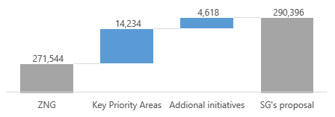
Maximum Expenditure Scenarios (2024-2027)
Same nominal level as in 2020-2023; therefore, absorbing the impact of the inflation estimated to CHF 6.4 million and reducing programmatic funds available
Zero Nominal Growth (ZNG) CHF 271.5 M Unable to finance most Key Priorities Areas
Zero Real Growth (ZRG) CHF 278.1 M (2.4% increase over ZNG) Considers inflation of CHF 6.5 million and provides initial funding for most key priority areas through de-prioritization of some core activities included in the ZNG scenario
Secretary-General’s Proposal CHF 290.4 M (6.9% increase over ZNG) Considers inflation of CHF 6.8 million and more fully finances key priority areas and other programmatic initiatives without de-prioritization core activities considered in the ZNG scenario.

Slide 14
Key Priority Areas – (Proposal by Scenario)
(in CHF thousands)
Key Priority Areas | Total funding included in each scenario | ZRG Scenario | SG’s Proposal
 | ZNG | ZRG | SG’s Proposal
Incremental Early Warnings for All | 3,560.4 | 6,130.9 | 6,130.9
WMO-coordinated Greenhouse Gas Watch | - | 1,899.9 | 2,649.9
Reorganization and optimization of Regional and Rep. Offices | - | 2,225.1 | 3,210.3
Additional needs for Plan of Action for Hydrology | - | 865.8 | 865.8
Cryosphere and Downstream Impacts | - | - | 1,357.2
Implementation of Enterprise Resource Planning System | - | 2,000.0 | 2,000.0
Implementation of IT Strategy and Security | - | 1,580.0 | 1,580.0
Total | 3,560.4 | 14,701.7 | 17,794.1

Slide 15
Early Warnings for All (EW4All)
Funding Summary
Majority funded in ZNG, full under all others
Activities across all LTGs as integrated effort
One additional position under ZNG scenario and one additional position under ZRG
Benefits of Additional Funding
Additional critical activities to Members, e.g.:
Technical guidance on IBF and warning services
Training materials on probabilistic forecasts
Increased Members’ migration to WIS 2.0
Investments in methodologies for IBF
Benefits of ZNG Funding
Members to be recognized as the single authoritative voice on warnings and hazards
Support to development of uniform norms and standard
Accelerated development with Tech Commissions
Extrabudgetary and Resource Mobilization
Critical for full implementation for whole WMO community
Significant extrabudgetary resources will be required
Some contributions already received – in discussion with a number of donors for further contributions

Slide 16
Global Greenhouse Gas Watch (GGW)
Funding Summary
Without funding, GGW would not be realized
ZRG includes two new staff positions
SG’s Proposal also includes additional activity funds
Benefits of Additional Funding
ZRG includes leadership role with the WMO community, including strong scientific coordination to support GGW
SG’s Proposal includes additional activity funding to support Members’ implementation
De-prioritization considerations under ZRG
Impact within LTG 2 and LTG 3 to maintain balance
Reduction of one staff with potential slowdown on GBON and RBON implementation
Reduced support to certain sectors within the GAW user community
Extrabudgetary and Resource Mobilization
Significant interest from public and private sector – WMO coordination needed
Resource expected for:
further coordination and monitoring efforts within WMO and
Accelerate and develop additional GGW activities and downstream services

Slide 17
Regional and Representative Office Reform
Funding Summary
Decisions on way forward are expected in 2024-2027 period
Need to ensure funding is available for eventual final decision – otherwise could be delay in implementation
Benefits of Additional Funding
ZRG would allow for strengthened staffing structure and regional offices for RAI once approach approved
SG’s Proposal includes additional offices in the second half of 2026-2027
De-prioritization considerations under ZRG
Elimination of one position supporting capacity development
Required funding for fellowship activities would need funding from extrabudgetary activities
Increase in virtual rather than hybrid RA meetings
Extrabudgetary and Resource Mobilization
Limited potential for extrabudgetary resources
Potential support from Members through secondment of staff to Regional Offices

Slide 18
Implementation of Plan of Action for Hydrology
Funding Summary
Based on Plan of Action approved by Cg-Ext(2021)
Funding requested is for one staff Member to support and coordinate implementation
Benefits of Additional Funding
Reduction in risk of non-implementation or delay
Focused coordination and monitoring of implementation
De-prioritization considerations under ZRG
Reduced funding under LTG 1 (e.g.):
Reduced support to leverage WMO WEB by the GMAS Framework
Minimal financial support to the FFI-Advisory Group
Reduction in trainings, demonstrations and seminars for aviation
Extrabudgetary and Resource Mobilization
Significant extrabudgetary resources already being mobilized for implementation under SO. 1.3 and efforts continue

Slide 19
Cryosphere and Downstream Impacts
Funding Summary
Relates to new SO 1.5
Only funded under Secretary-General’s Proposal – no funding would mean no implementation
Benefits of Additional Funding
Reduction in risk of non-implementation or delay
Focused coordination and monitoring of implementation
De-prioritization considerations under ZRG
None as not funded under ZRG
Extrabudgetary and Resource Mobilization
Extrabudgetary resources would be required to support implementation
Efforts on resources mobilization would begin once commitment made by WMO to implement

Slide 20
Investment in ERP and IT Strategy
Funding Summary
Full funding under ZRG and SG’s Proposal
Majority funding from other sources:
Savings from 2020-2022
Programme Support Costs
Benefits of Additional Funding
Improved protection from and resilience to cybersecurity risks
Improvements to efficiency and quality of IT services within WMO
Full implementation of the ERP with value-added elements
Impact of not Funding
Increased risk of business disruption or loss due to cybersecurity issues
Postponing introduction of efficiencies and improvements to quality of IT services
Limited support for project management or enhancement of reporting within the ERP
Extrabudgetary and Resource Mobilization
Limited potential for extrabudgetary contributions given the nature of the activities as core to WMO Secretariat

Slide 21
Additional Elements Funded under SG’s Proposal
Impact of Additional Elements
Strengthen the functions and coordination of the liaison office in Brussels, focusing on joint efforts or and coordination with EUMETNET, ECMWF and EMETSAT
Investment in Atmospheric Environment Research Division to strengthen the work of GAW and the coordination of WMO and the GAW community
Improving the timeliness and completeness of the delivery of the Strategic Plan and Operating Plan, for example:
LTG 2 – Advancing the implementation of the WIGOS to support Members (e.g. the 2040 Vision Space Component, increased capacity development)
LTG 3 – Increased scope of prediction products provided and increased data assimilation utilizing AI for faster statistical models
LTG 4 – 33% increase in Members supported through twinning coordination on QMS, 12 workshops delivered on strengthened stakeholder project management and implementation
LTG 5 – Improved greening of IT through power and backup space management
LTG 6 – Improved top-level political engagement by WMO

Slide 22
Additional Details

Slide 23
Alignment with the Strategic and Operating Plan

Slide 24
Revised Operating Plan 2024-2027
Reflects the 3 budget scenarios
Colour-coded budget-scenario impact on output delivery
Green: same level of implementation as SG proposal
Yellow: partially reduced level of implementation as compared to SG’s proposal
Pink: no implementation planned under this budget scenario

Slide 25
Additional Details Influencing the Scenarios
Inflation
Represents the estimated financial impact in the WMO budget as result of the increase in the price of good, services and salaries over the Financial Period, quantifying the loss in purchasing power of the organization to deliver its mandate as compared to a nominal budget.
Economies and Efficiencies
Financial and programmatic impact of measures, innovations and transformation in processes, technology and structures resulting in more efficient use of resources and savings reinvested in programmatic areas – already incorporated in the budget scenarios.
Apportioned costs
Represents all indirect and administrative costs incurred by the Organization. Those cost are disclosed and described in the budget document and proportionally apportioned by Long-Terms Goals/Budget parts in line with the adopted budget format. Represents less than 20% in all scenarios.
CHF 6.5 M
CHF 5.8 M
CHF 51.7 M

Slide 26
Inflationary Impact by Scenario
Component | Amount in millions of Swiss francs | ZRG Scenario | SG’s Proposal
 | ZNG Scenario | ZRG Scenario | SG’s Proposal
Staff Cost | 4.3 | 4.3 | 4.5
Non-Staff Cost | 1.2 | 1.3 | 1.4
Energy Costs | 0.9 | 0.9 | 0.9
Total | 6.4 | 6.5 | 6.8
Utilize internationally recognized International Monetary Fund (IMF) providing forecast for all of Switzerland. Most recent update was published in April 2023 ,including long-term forecast through 2027
Currently estimated to be an average of approximately 2% over the full financial period, but could be more significant in early periods
Inflation has not been calculated on certain non-staff costs (i.e. repayment of the loan) not impacted by inflation
Historical impact of the inflation on the WMO budget from 1996 to 2023:

Slide 27
Economies and Efficiencies
Realized in the 18th Financial Period
These efficiencies in the administration area were reinvested during the Financial Period 2020-2023 and are contained in the budget scenarios 2024-2027:
Investment in mid-level Professional Staff with knowledge in critical technical areas
Contributions to regional activities, primarily through the creation and filling of seven additional positions in Regional Offices
Additional efficiencies planned for
the 19th Financial Period
Rationalization of Indirect Costs – CHF 3.8 million
Reviewed administrative services support to extrabudgetary activities
Reassignment of costs to be funded by Programme Support Cost Special Account (rather than Regular Budget)
Additional administrative savings – CHF 2.0 million
Additional reprofiling of administrative positions toward programmatic activities
>CHF 5.3 M
CHF 5.8 M

Slide 28
Apportioned Cost within the Scenarios
(in CHF thousands)
Apportioned Costs | ZNG Scenario | ZRG Scenario | SG’s Proposal
Legal and Administrative Costs | 21,718.2 | 21,718.2 | 21,718.2
IT Operating and management costs | 12,984.8 | 16,564.8 | 16,564.8
Building Operations and management costs | 11,049.2 | 11,049.2 | 11,049.2
Repayment of building loan | 5,909.2 | 5,909.2 | 5,909.2
Total Apportioned Costs | 51,661.4 | 55,241.4 | 55,241.4
Apportioned Costs as % of Scenario | 19.0% | 19.9% | 19.0%
The apportioned costs are allocated to each of the Appropriation Parts as they support the implementation of the Appropriation Parts

Slide 29
Objects of Expenditure

Slide 30
View of Scenarios by Object of Expenditure
(in Percentage)
Object of Expenditure | ZNG Scenario (in %) | ZRG Scenario (in %) | SG’s Proposal (in %)
Staff costs | 73.7% | 73.2% | 71.9%
Short-term staff and consultancy service | 4.5% | 4.8% | 5.1%
Travel – Experts | 5.8% | 5.6% | 6.4%
Travel - Staff | 1.6% | 1.6% | 1.7%
Fellowships and training activities | 1.1% | 0.9% | 1.1%
Grants and financial contributions | 1.9% | 1.9% | 2.0%
Contractual services and operating expenses | 9.2% | 9.9% | 9.8%
Repayment of the loan for WMO HQ building | 2.2% | 2.1% | 2.0%
Total by Objects of Expenditure | 100.0% | 100.0% | 100.0%

Slide 31
Expenditure Trends in the 18th Financial Period
Expenditures and operations during the second biennium (2022-2023) of 18th Financial Period increasing. Planned near full spend of available funds, including unspent funds from 2020-2021:
Travel and other operations increasing since mid-2022 as COVID-19 pandemic restrictions were reduced
Inflationary impacts, particularly on energy, impacting expenditures
Unspent funds from 2020-2021 approved for re-utilization by EC-73
Being utilized for deferred programmatic activities and growing demands on WMO
Supporting critical investment needs (e.g. Headquarters Building, ERP upgrade, Regional Office IT infrastructure)
Final elements of Secretariat reorganization
Reinvestment in technical staff from generated administrative staff costs savings was mostly completed in 2022

Slide 32
Draft Resolution

Slide 33
Maximum Expenditures 2024-2027 – Draft Resolution
Draft Resolution 3.1(2)/1 (Cg-19)
Authorizes the Executive Council during the nineteenth financial period from 1 January 2024 to 31 December 2027:
(1) To incur maximum expenditures of XXX XXX XXX Swiss francs to be funded through assessed contributions;
(2) To distribute the regular budget resources by appropriation part as provided in the annex to this resolution;
(3) To approve the biennial appropriations for 2024–2025 and for 2026–2027 within these limits;
Further authorizes the Executive Council to incur other expenditure from voluntary resources contributing to enhanced implementation of programme activities in line with the Strategic Plan, including co-sponsored programmes and initiatives;
Requests the Secretary-General to monitor the implementation of the Operating Plan at both the outcome and output levels, in accordance with the WMO monitoring and evaluation system, in particular in relation to the use of budgetary resources;
Invites Members to consider contributing voluntary resources to accelerate, expand and/or scale up the implementation of the Long-term Goals and Strategic Objectives of the Strategic Plan for 2024–2027.

Slide 34
Maximum Expenditure Scenarios by Appropriations Parts
(in CHF thousands)
Budget Parts
 | ZNG | ZRG | SG's proposal | Average Percentage
Part I. LTG 1. Better serve societal needs | 55,458.9 | 57,454.3 | 59,881.5 | 20.6%
Part II. LTG 2. Enhance Earth system observations and predictions | 49,903.4 | 52,464.8 | 55,008.2 | 18.7%
Part III. LTG 3. Advance targeted research | 24,735.9 | 25,264.9 | 27,790.7 | 9.3%
Part IV. LTG 4. Close the capacity gap | 60,343.1 | 60,932.5 | 64,610.0 | 22.1%
Part V. LTG 5 Strategic realignment of WMO structure and programmes | 4,721.4 | 4,771.8 | 5,030.5 | 1.7%
Part VI. Policy-Making Organs, Executive Management and Oversight | 42,702.2 | 43,150.2 | 44,396.9 | 15.5%
Part VII. Language and Conference Services | 33,679.5 | 34,032.9 | 33,678.6 | 12.1%
TOTAL | 271,544.4 | 278,071.4 | 290,396.4
Percentage represented by apportioned costs | 19.0% | 19.9% | 19.0%

Slide 35
Remaining Process – Max Expenditures 2024-2027
Cg-19 (May 2023)
Cg-19 budget subcommittee considers and provides additional guidance
Consensus reached on final maximum expenditure scenario
Approval by Cg-19
EC-77 (June 2023)
Secretariat updates EC-77 decision and information documents on Budget 2024-2025 after Cg-19 approval
Considers and approves Budget 2024-2025, in line with Cg-19 decision

Slide 36
FINAC Recommendation
Recommendation 3:
“That Congress:
Discusses and reaches consensus on the proposed Maximum Expenditures for the nineteenth financial period and
adopts Resolution 3.1(2)/1 (Cg-19) – Maximum Expenditures for the nineteenth financial Period (2024-2027)”

